Slide 1
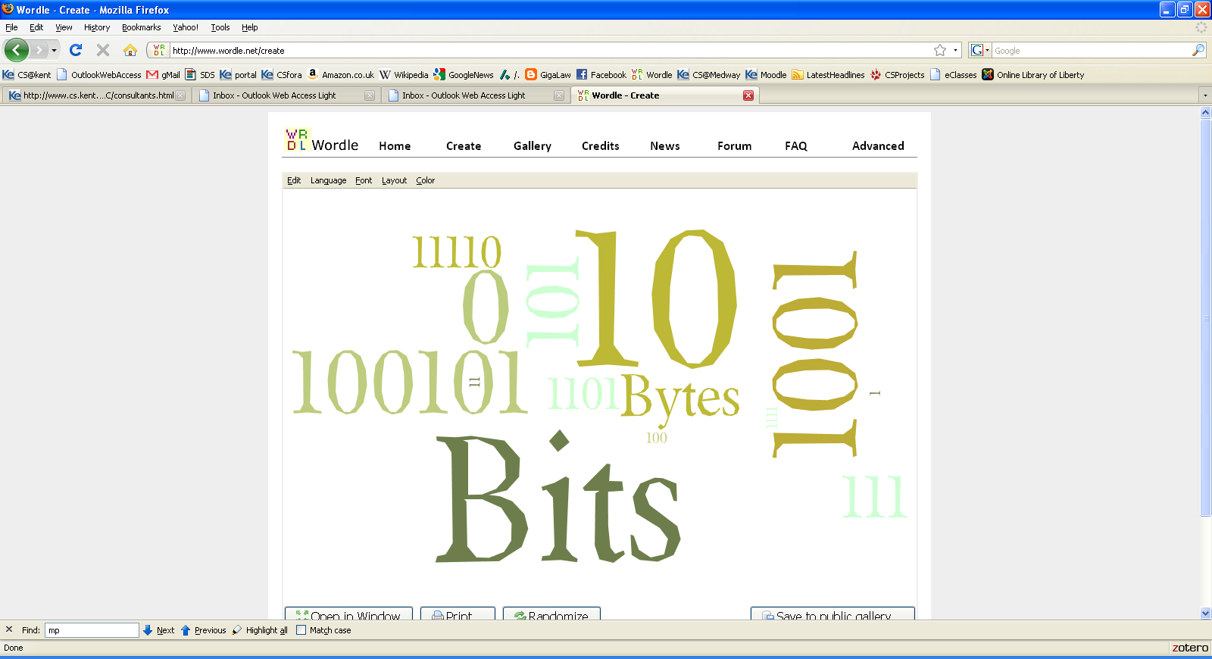

Slide 2
Computer Organization and Architecture
Lab #1
Fazlullah Khan
Computer Science Department
Military College of Signals, NUST

Slide 3
Course Contents
1. Week -1
  Examination of a PC
  Bits & Bytes
  Numbering System
  Conversion (Base(x) to Base(y))
2. Week -2
  Introduction to emulator
  Introduction to DOS
3. Week - 3
  Logical Organization of the PC
    CPU
    Memory
      Registers
      Stack
4. Week – 4 & 5
  Assembly language programming
    Structure of assembly program
    Linux System Calls
  Linux on virtual machines
    Installation of NASM
    Compile and debug a program

Slide 4
Course Contents
5. Week -6 & 7
  First Assembly Program exit()
  Practice of the first program
  Hello World Program
  Debugging using GNU debugger and GAS compiler
6. Week -8
  Data Types
  Basic Instructions
7. Week -9
  Commands
    mov
    add
    sub etc
8. Week -10 & 11
  Working with String
    Loading and Comparing of strings
    Conditional & Unconditional Branching

Slide 5
Course Contents
9. Week -12
  Function in Assembly Language using GAS Compiler
    Writing user defined functions
    Passing arguments and returning values
10. Week -13
  Some hands on experience on microcontroller

Slide 6
Numbers
What is a number
Numbers are things that we count with
Numbers have an order
We add numbers together to get other numbers.
Something that we use numerals to represent numbers
(Numerals - 'arabic' 'roman' 'chinese‘)
Notes:
CO332
R.G.Keim@kent.ac.uk

Slide 7

Symbols represent numbers
Different shapes, different words, different symbols
one ONE one one one 1 1
Roman numerals I and i
Chinese characters
Zero 0
What ІІ represents depends on the context
Notes:
CO332
R.G.Keim@kent.ac.uk
Eleven,
Two ones
Or (in binary the number 3)
In hex 11 = sixteen plus one or seventeen.

Slide 8
Human number systems
Roman system (every so often need a new symbol)
  I II III IV V VI VII VIII IX X
  ID D DI IL L LI IM M MI
Base ten (ours, Arabic, Indian, …)
0 1 2 3 4 5 6 7 8 9 (don’t need new symbols)
10 100 1000 10000 100000 …
decimal system (positional base 10)
Notes:
CO332
R.G.Keim@kent.ac.uk

Slide 9
Number systems
Base "two" – uses two symbols = Binary
These symbols could be almost anything
Could be written with zeros and ones –
0 and 1
Base "ten" – uses ten symbols = Decimal
  could be written with using our usual numerals
  0, 1, 2, 3, 4, 5, 6, 7, 8, 9
Notes:
CO332
R.G.Keim@kent.ac.uk

Slide 10
Between Machines & end-users
Machines use binary representations internally
(It's fast, convenient, easy direct and useful)
For end users, machines are designed to convert to the standard representation (0,1,2,3,4,5,6,7,8,9)
Notes:
CO332
R.G.Keim@kent.ac.uk

Slide 11
Digitizing Information
Digitize – to represent information with digits
Digitize originally meant using the ten numerals ‘0’ through ‘9’
Telephone numbers, National Insurance numbers, etc. are examples of digitized information.
Notes:
CO332
R.G.Keim@kent.ac.uk

Slide 12
Machines and People
Computing machines
manipulate 0s and 1s
Deep in a computer everything is
0s and 1s
Computer programs
Computer data
People 'manipulate'
Numbers, Words, Images
Words – spoken language
‘Images’ (symbols) used to represent spoken language
Notes:
CO332
R.G.Keim@kent.ac.uk

Slide 13
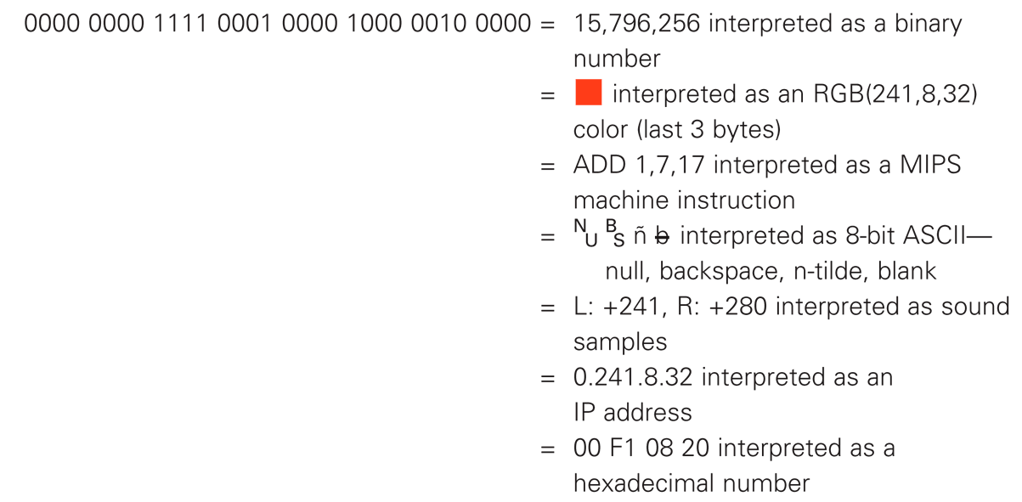
“bits are bits”
The same 4 bytes shown can be interpreted differently depending on context.
Copyright © 2006 Pearson Addison-Wesley. All rights reserved.
Notes:
CO332
R.G.Keim@kent.ac.uk

Slide 14
Bits For Symbols
Bit stands for binary digit.
Though bit sequences can be interpreted as binary numbers, the key idea is that bits form symbols.
Notes:
CO332
R.G.Keim@kent.ac.uk

Slide 15
Bits in Magnetic Media
The two patterns are called states of the bit when they are part of a storage medium.
0110 1000 1011 0101
Notes:
CO332
R.G.Keim@kent.ac.uk

Slide 16
Bits in Computer Memory
Bits in a computer are arranged much like a sidewalk.
A stone on a strip of concrete could be considered a 1 while the absence of a stone could be considered a 0.
Could just as easily be black and white; where black would be present and white as absent.
Notes:
CO332
R.G.Keim@kent.ac.uk

Slide 17
n bits | 2^{n} | Represent
1 | 2¹ | 2
2 | 2² | 4
3 | 2³ | 8
4 | 2⁴ | 16
5 | 2⁵ | 32
6 | 2⁶ | 64
7 | 2⁷ | 128
8 | 2⁸ | 256
9 | 2⁹ | 512
10 | 2¹⁰ | 1024
Notes:
CO332
R.G.Keim@kent.ac.uk

Slide 18
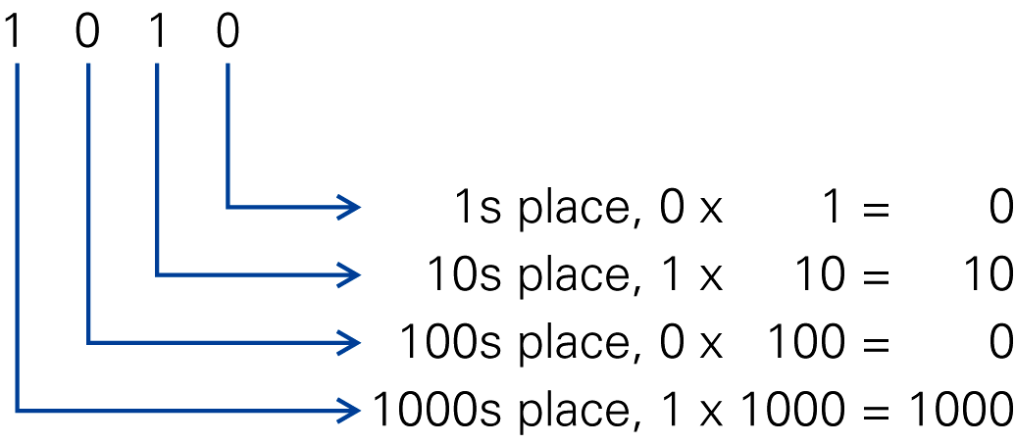
The decimal number 1010
representing one thousand ten = 10 + 1000.
Notes:
CO332
R.G.Keim@kent.ac.uk

Slide 19
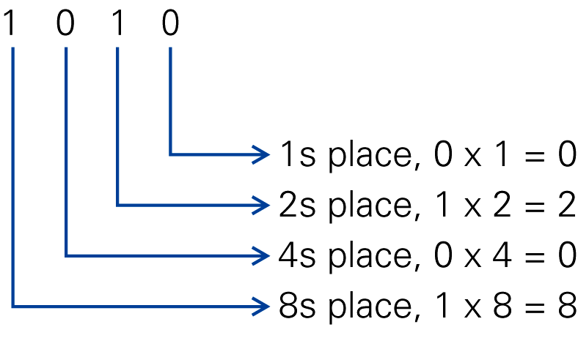
The binary number 1010
representing the decimal number ten = 2 + 8.
Notes:
CO332
R.G.Keim@kent.ac.uk

Slide 20
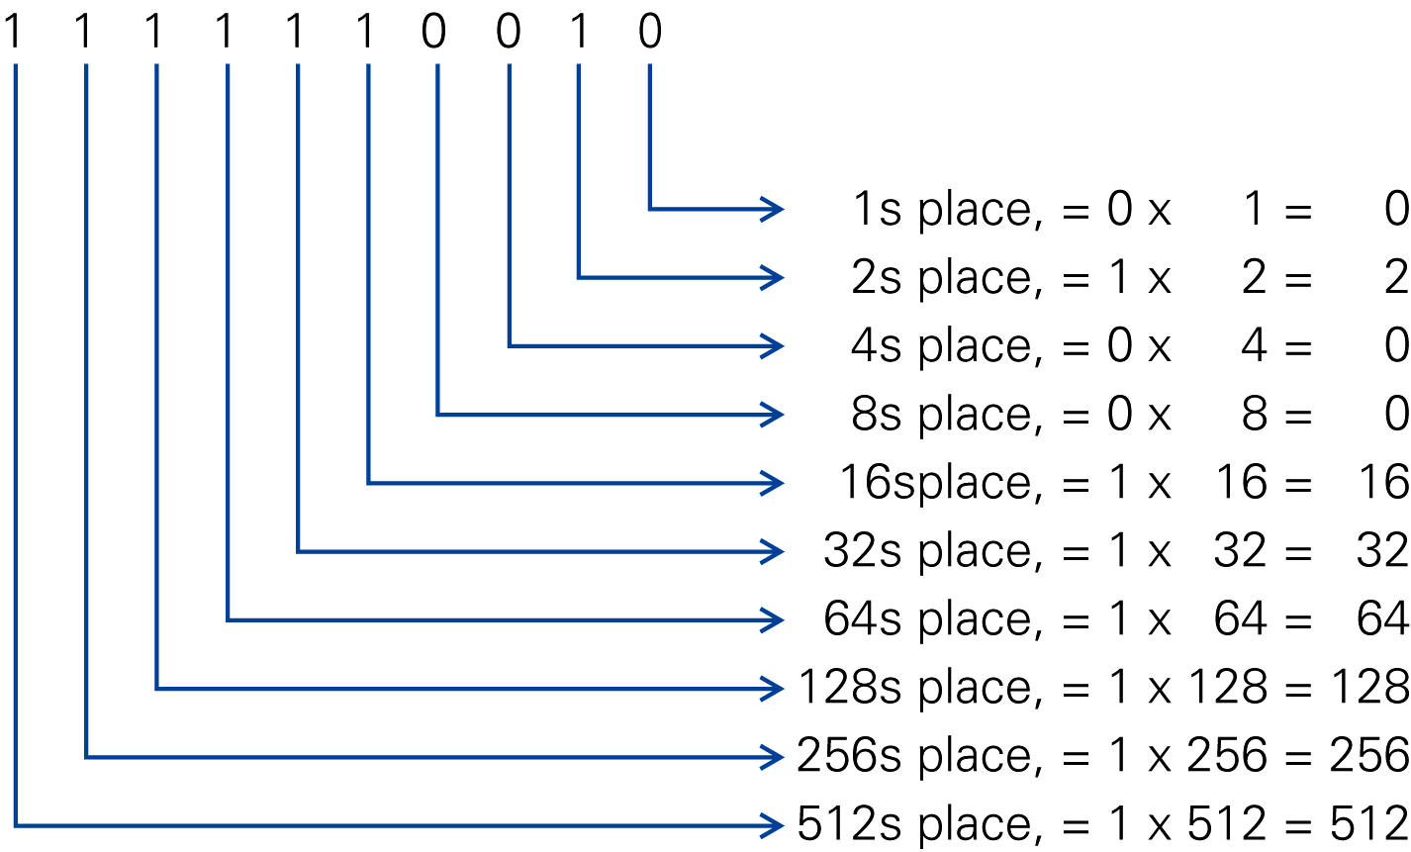
Binary representation of the 1010
the decimal number one thousand ten = 2 + 16 + 32 + 64 + 128 + 256 + 512
Copyright © 2006 Pearson Addison-Wesley. All rights reserved.
Notes:
CO332
R.G.Keim@kent.ac.uk

Slide 21
Byte Ordering
How should bytes within multi-byte word be ordered in memory?
Conventions
  Big Endian: Sun, PPC Mac, Internet
    Least significant byte has highest address
  Little Endian: x86
    Least significant byte has lowest address

Slide 22
Byte Ordering Example
Big Endian
  Least significant byte has highest address
Little Endian
  Least significant byte has lowest address
Example
  Variable x has 4-byte representation 0x01234567
  Address given by &x is 0x100
Big Endian
0x100
0x101
0x102
0x103
01
01
23
23
45
45
67
67
Little Endian
0x100
0x101
0x102
0x103
67
67
45
45
23
23
01
01

Slide 23
Numbers and Bases
Each number can be decomposed into a sum of terms
Each term is the product of two factors
  A digit (from 0 to 9)
  The base (10) raised to a power corresponding to the digit’s position in the number
25 = 2*10¹ + 5*10⁰
136 = 1*10² + 3*10¹ + 6*10⁰
Any number can be written in base b, where b is an integer.
  If b = 10 we have “decimal” with 10 digits [0-9]
  If b = 2 we have “binary” with 2 digits [0-1], which are also called bits
  If b = 8 we have “octal” with 8 digits [0-7]
  If b = 16 we have “hexadecimal” with 16 digits [0-9,A,B,C,D,E,F]

Slide 24
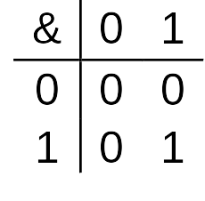
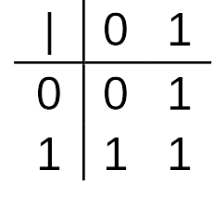
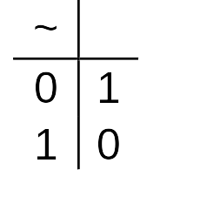
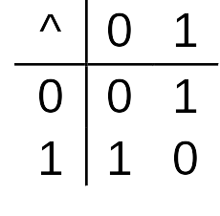
Boolean Algebra
Developed by George Boole in 19th Century
  Algebraic representation of logic
    Encode “True” as 1 and “False” as 0
And
  A&B = 1 when both A=1 and B=1
Or
  A|B = 1 when either A=1 or B=1
Not
  ~A = 1 when A=0
Exclusive-Or (Xor)
  A^B = 1 when either A=1 or B=1, but not both

Slide 25
General Boolean Algebras
Operate on Bit Vectors
  Operations applied bitwise
All of the Properties of Boolean Algebra Apply
01101001
& 01010101
01000001
01101001
| 01010101
01111101
01101001
^ 01010101
00111100
~ 01010101
10101010
01000001
01111101
00111100
10101010

Slide 26
Converting from Binary to Decimal
We denote by XXXX₂ a binary representation of a number and by XXXX₁₀ a decimal representation
Converting from binary to decimal is straightforward:
10010110₂ = 1*2⁷ + 1*2⁴+1*2²+1*2¹
= 1*128 + 1*16 + 1*4 + 1*2
= 150₁₀
The rightmost bit of a binary number is called the least significant bit
The leftmost non-zero bit of a binary number is called the most significant bit
If the least significant bit is 0, then the number is even, otherwise it’s odd

Slide 27
Converting from Decimal to Binary
The conversion here is a little bit more complicated
It proceeds by a series of integer divisions by 2, and by recording the remainder of the division
  Integer division a/b: a = b* q + remainder, where all are integers
Example: converting 37₁₀ into binary
  Divide 37 by 2: 37 = 2*18 + 1
  Divide 18 by 2: 18 = 2*9 + 0
  Divide 9 by 2: 9 = 2*4 + 1
  Divide 4 by 2: 4 = 2*2 + 0
  Divide 2 by 2: 2 = 2*1 + 0
  Divide 1 by 2: 1 = 2*0 + 1
  Result: 100101₂
The least significant bit is computed first
The most significant bit is computed last

Slide 28
Binary Addition
Basic Rules:
01 1
+01 + 01
= ^{C}10 +01
= ^{C}11
00 00
+ 00 +01
= 00 = 01

Slide 29
Binary Addition
Examples:
1 0 0 1 9₁₀
+ 1 1 1 1 + 15₁₀
= 1 1 0 0 0 = 24₁₀
1 0 1 0 0 1 1 0 166₁₀ + 1 1 0 0 0 0 1 1 + 195₁₀
= 1 0 1 1 0 1 0 0 1 = 361₁₀

Slide 30
Counting in Hexadecimal
0₁₆=0₁₀ A₁₆=10₁₀ 14₁₆=20₁₀ 1E₁₆=30₁₀
1₁₆=1₁₀ B₁₆=11₁₀ 15₁₆=21₁₀ 1F₁₆=31₁₀
2₁₆=2₁₀ C₁₆=12₁₀ 16₁₆=22₁₀ 20₁₆=32₁₀
3₁₆=3₁₀ D₁₆=13₁₀ 17₁₆=23₁₀ 21₁₆=33₁₀
4₁₆=4₁₀ E₁₆=14₁₀ 18₁₆=24₁₀ 22₁₆=34₁₀
5₁₆=5₁₀ F₁₆=15₁₀ 19₁₆=25₁₀ 23₁₆=35₁₀
6₁₆=6₁₀ 10₁₆=16₁₀ 1A₁₆=26₁₀ 24₁₆=36₁₀
7₁₆=7₁₀ 11₁₆=17₁₀ 1B₁₆=27₁₀ 25₁₆=37₁₀
8₁₆=8₁₀ 12₁₆=18₁₀ 1C₁₆=28₁₀ 26₁₆=38₁₀
9₁₆=9₁₀ 13₁₆=19₁₀ 1D₁₆=29₁₀ 27₁₆=39₁₀

Slide 31
Converting from hex to decimal
This is again straightforward
A203DE₁₆ = 10*16⁵ + 2*16⁴ + 0*16³ + 3*16²+13*16¹+14*16⁰
= 10,617,822₁₀

Slide 32
Converting from decimal to hex
Use the same idea as for binary
Example: convert 256₁₀
  256/16 Result = 16 Remainder = 0
  16/16 Result = 1 Remainder = 0
  Result: 100₁₆

Slide 33
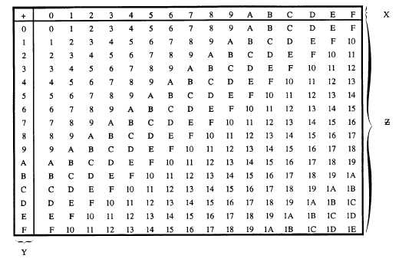
Hexadecimal addition

Slide 34
Hexadecimal addition
c
A 2 3 F 41535₁₀
+ 3 D 1 3 + 15635₁₀
= D F 5 2 = 57170₁₀
D 1 F F 53759₁₀
+ A 4 D F + 42207₁₀
= 1 7 6 D E = 95966₁₀
c
c
c

Slide 35
Why is hexadecimal useful?
We need to think in binary because computers operate on binary quantities
But binary is cumbersome
However, hexadecimal makes it possible to represent binary quantities in a compact form
Conversions back and forth from binary to hex are straightforward
  Just convert hex digits into 4-bit numbers
  Just convert 4-bit binary numbers into hex digits

Slide 36
Converting from hex to binary
Consider A43FE2₁₆
We convert each hex digit into a 4-bit binary number:
  A: 1010
  4: 0100
  3: 0011
  F: 1111
  E: 1110
  2: 0010
We “glue” them all together:
  A43FE2₁₆ = 101001000011111111100010₂
Note that:
  You must have the leading 0’s for the 4-bit numbers, which is what a computer would store anyway
  It all works because F₁₆ = 15₁₀, and a 4-bit number has maximum value of 2⁴-1 = 15₁₀

Slide 37
Converting from binary to hex
Let’s convert 1001010101111₂ into hex
We split it in 4-bit numbers, which we convert separately
First we add leading 0’s to have a number of bits that’s a multiple of 4:
  0001 0010 1010 1111
Then we convert
  0001₂ : 1₁₆
  0010₂ : 2₁₆
  1010₂ : A₁₆
  1111₂ : F₁₆
And the result: 1001010101111₂ = 12AF₁₆

Slide 38
Integer representation
A computer needs to store integers
These numbers are stored using different numbers of bytes (1 byte = 8 bits):
  1-byte: “byte”
  2-byte: “half word” (or “word”)
  4-byte: “word” (or “double word”)
  8-byte: “double word” (or “paragraph”, or “quadword”)
  Different computers have used different word sizes, so it’s always a bit confusing to just talk about a “word” without any context
Regardless of the number of bytes, these integers are stored in binary
Integers come in two flavors:
  Unsigned: values from 0 to 2^{b}-1
  Signed: negatives values, with about the same number of negative values as the number of positive values

Slide 39
Signed Magnitude
Storing unsigned integers is easy: just store the bits of the integer’s binary representation
Storing signed integer raises a question: how to store the sign?
One approach is called signed magnitude: reserve the leftmost bit to represent the sign
00100101 denotes + 0100101₂
10100101 denotes - 0100101₂

Slide 40
One’s complement
Another idea to store a negative number is to take the complement (i.e., flip all bits) of its positive counterpart
Example: I want to store integer 87
  87₁₀ = 01010111₂
  Let’s take the complement: 10101000

Slide 41
Two’s complement
Computing the 2’s complement is in 2 steps:
  Compute the 1’s complement of the positive number
  Add 1 to the result
  This is the representation of the negative number
Example: Let’s represent -87
  87₁₀ = 01010111₂ = 57₁₆
  1’s complement: 10101000₂ = A8₁₆
  Add one: 10101001₂ = A9₁₆

Slide 42
What does ІІ represent?
It depends on the context
There are at least four reasonable numerical answers that are not just random choices of meaning for ‘I’
Notes:
CO332
R.G.Keim@kent.ac.uk
Eleven,
Two ones
Or (in binary the number 3)
In hex 11 = sixteen plus one or seventeen.

